Slide 1
ACT from bottom up
JoAnne Dahl Niklas Törneke
ACBS World congress X Washington 2012

Slide 2
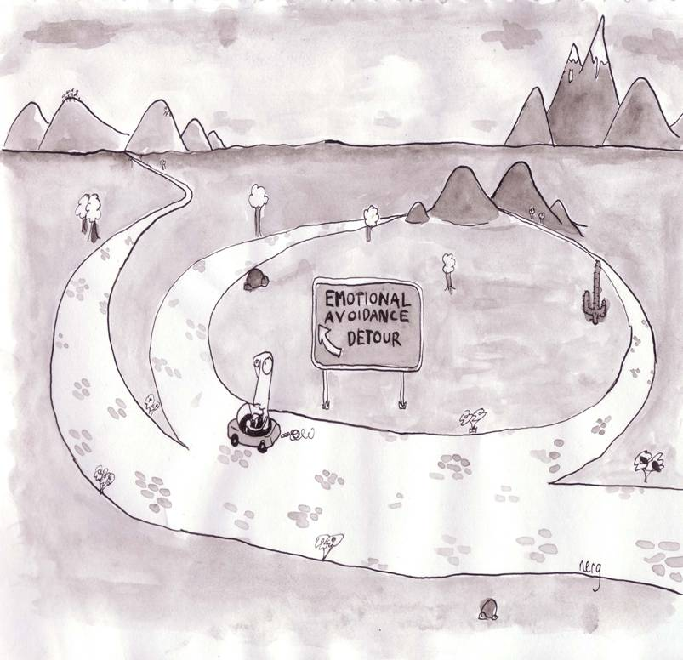

Slide 3
Theoretical assumptions
CONTEXT
Radical behaviorism/functional contextualism
Principles of change: operant and
respondent learning
CONTEXT

Slide 4
Respondent
Unconditioned stimulus (US) Unconditioned response (UR)
Conditioned
stimulus
(CS)
Conditioned response (CR)
Operant
Antecedent Behavior
Consequence

Slide 5
CONTEXT
CONTEXT

Slide 6
An important detail: Private events/subtle behavior
Private events as behavior
What is first clear and evident becomes subtle or “weak”
Subtle behavior and it’s effect on behavior more generally

Slide 7
Operant behavior
Flexibility and the risk of rigidity

Slide 8
Operant behavior
CONTEXT
CONSEQUENCE
The critique ends
Finds the keys
Left alone
Putting the hand in left pocket
Turns silent, looks down
Aggressive outburst
CONTEXT
“Fuck off!”
ANTECEDENT
“Do you have the keys?”
A gaze of interest
Critized

Slide 9
CONSEQUENCE
Different types of consequences:
Those that increase the probability of a certain behavior: reinforcing
Those that decrease the probability of a certain behavior: punishing
All behavior that persists is reinforced in one way or another
A primary reinforcer (punisher) and a learned reinforcer (punisher)
ANTECEDENT

Slide 11
Relational framing
Increased flexibility – and the risk of more rigidity

Slide 12
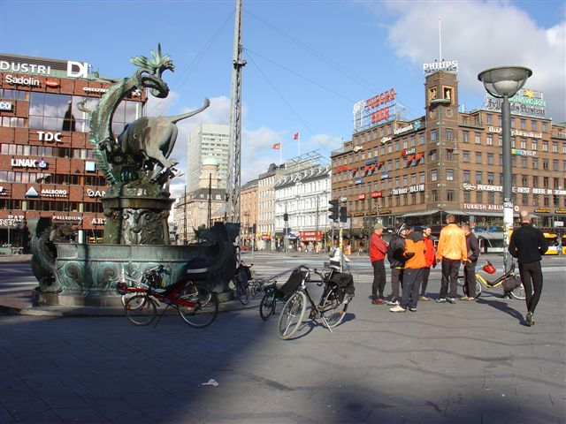

Slide 13
Interacting with relations between stimuli
Non–arbitrary relations

Slide 14
Relating controlled by arbitrary contextual cues
&
@
#
>
=
# is the same as a hard punch on the nose
# is the same as 10000 dollars

Slide 15
Contextual change that affects behavior
Contingencies, operant and respondent
Generalisation
Relations based on physical characteristics of stimuli
LESS THAN
Humans learn to relate stimuli independently of the stimuli
related
Some contextual factors influence our way to relate stimuli and
therby stimulus function (the effect stimuli have on our
behavior) change
This is the key to understanding human language and cognition
MORE THAN

Slide 16
Different relations
AFTER
IN FRONT OF
LESS THAN
MORE THAN
BEFORE
BEHIND

Slide 17
An exercise
In what way is…
1. 1. behind 1.
2. 2. longer than 2.
3. 3. before 3.
4. 4. better than 4.
5. 5. inside 5.
6. 6. same as 6.
7. 7. part of 7.

Slide 18
Relational framing and it’s effect on human behavior
Two main areas:
The ability to follow instructions (rule governed behavior)
The way we interact with our own behavior (self)
Notes:
Choclate cake and me in a swimming suit
My action now and where I will spend eternity
My action now and the environment of my grandchildren
Dealing with things “in my head”

Slide 19
Consequence
Fusion: Not distinguishing, in the moment, “I” from subtle/private self–instructions (your own responses)
Experiential avoidance: Following of self-
instructions to control, extinguish or lessen
private responses such as feelings, thoughts,
memories and bodily sensations
Better–worse
More–less
If–so
Rigidity
Now–later
…is the same as…
Antecedent

Slide 20
RFT and it’s clinical implications (ACT)

Slide 21
Flexibility
Fusion
Effective action
Experiential avoidance
Defusion
Rigidity

Slide 22
What is defusion?
When we are fused with our own responses (feelings, thoughts, memories) these responses are in coordination with the responder (“I”). I am one with my thoughts and feelings, acting “in” or “on” them
Defusion is to relate to your own responses as “I–there–then”, as with a distance from you, a distance optimal for observation
Events framed “I–there–then” have different stimulus functions (effect your behavior differently) from events framed “I–here–now”

Slide 23
What is effective action?
In experiential avoidance your own private responses (thoughts, feelings, memories) are in opposition to effective action. As if you can not move with these present
Frame problematic private events (your own responses) in coordination with effective action and you can move. Carry them with you and go!
Effective action for what? Values
Defusion and effective action go together, are part of the same movement: flexibility
Notes:
In problematic EA you act as if the most important is to avoid certain private responses (events)
To take effective, valued action with problematic events present is to have them in coordination with such action

Slide 24
ACT as “therapy of self”
You and yourself, the trap of rigidity: Not distinguishing between yourself and your private responses (fusion) and… Setting your private responses in opposition to valued action (experiential avoidance)
You and yourself, back to flexibility: Act in relation to your private responses so that you can observe them with a distance (defusion) and… Accept them as a part of action in the direction you want to go (effective action)

Slide 25
Tools for therapy
Functional analysis is at the root of ACT
Functional analysis
What behavior should be analyzed? First and second scene.
Which are the contextual factors (antecedents and consequences)
influencing this behavior?
Analysis of both excesses (problematic behavior)
and deficiences (alternative behavior)
Watch out for fusion and experiential avoidance
Work towards defusion and effective action
Metaphor
Experiential excercises

